Slide 1
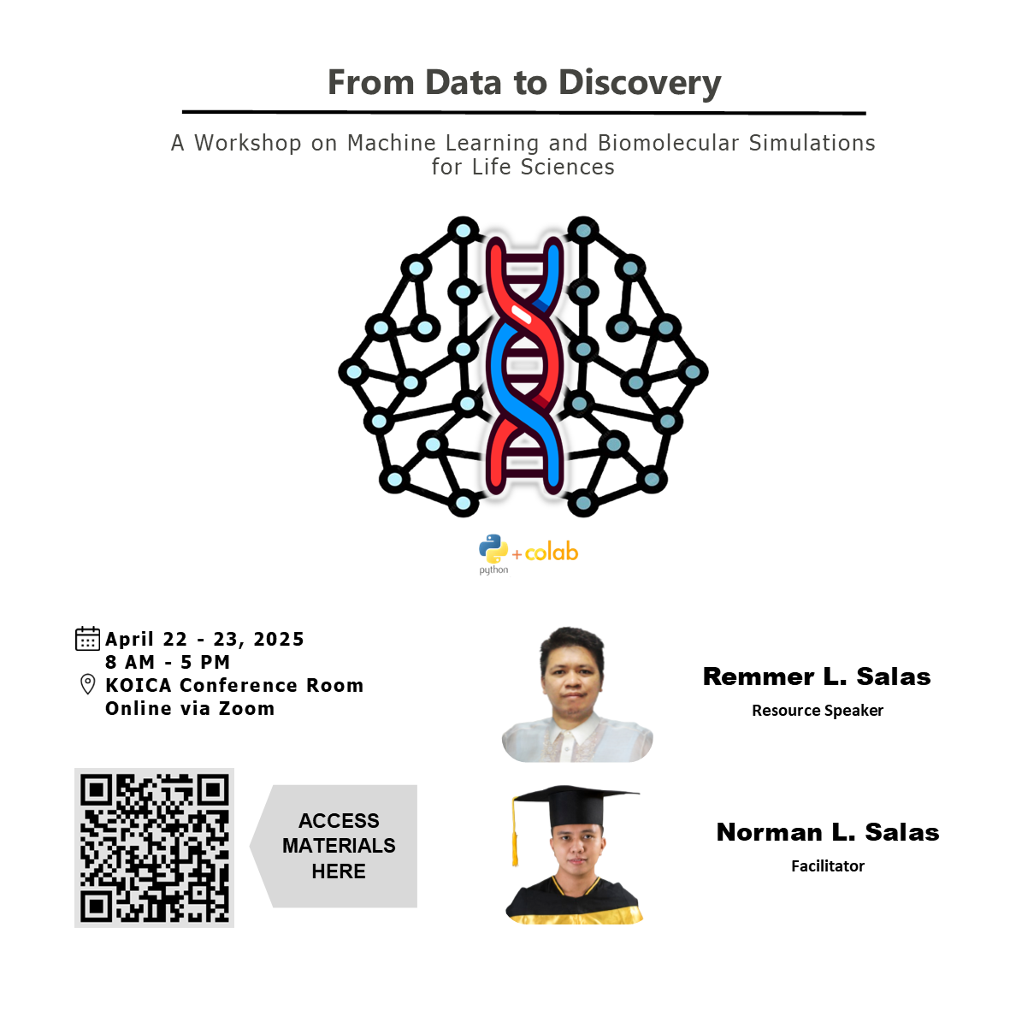

Slide 2
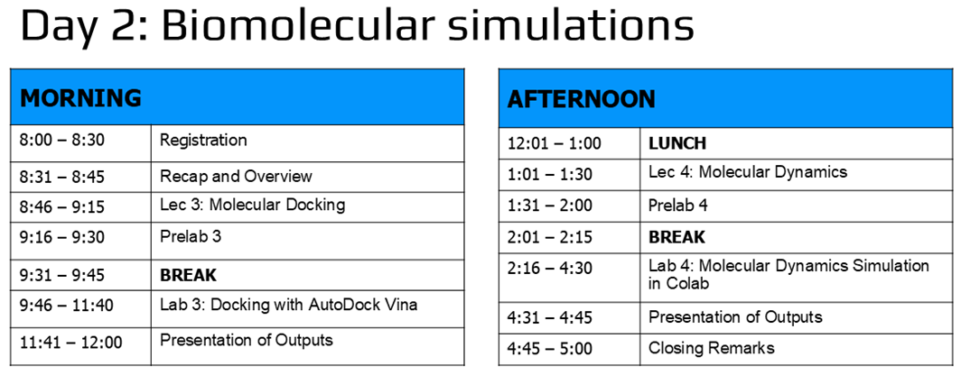

Slide 3
Molecular dynamics*
LECTURE 4
Remmer L. Salas
Chemistry Instructor
Department of Natural Sciences and Mathematics
Visayas State University
*Modified from Charlie Laughton presentation in CompBio Asia 2022

Slide 4
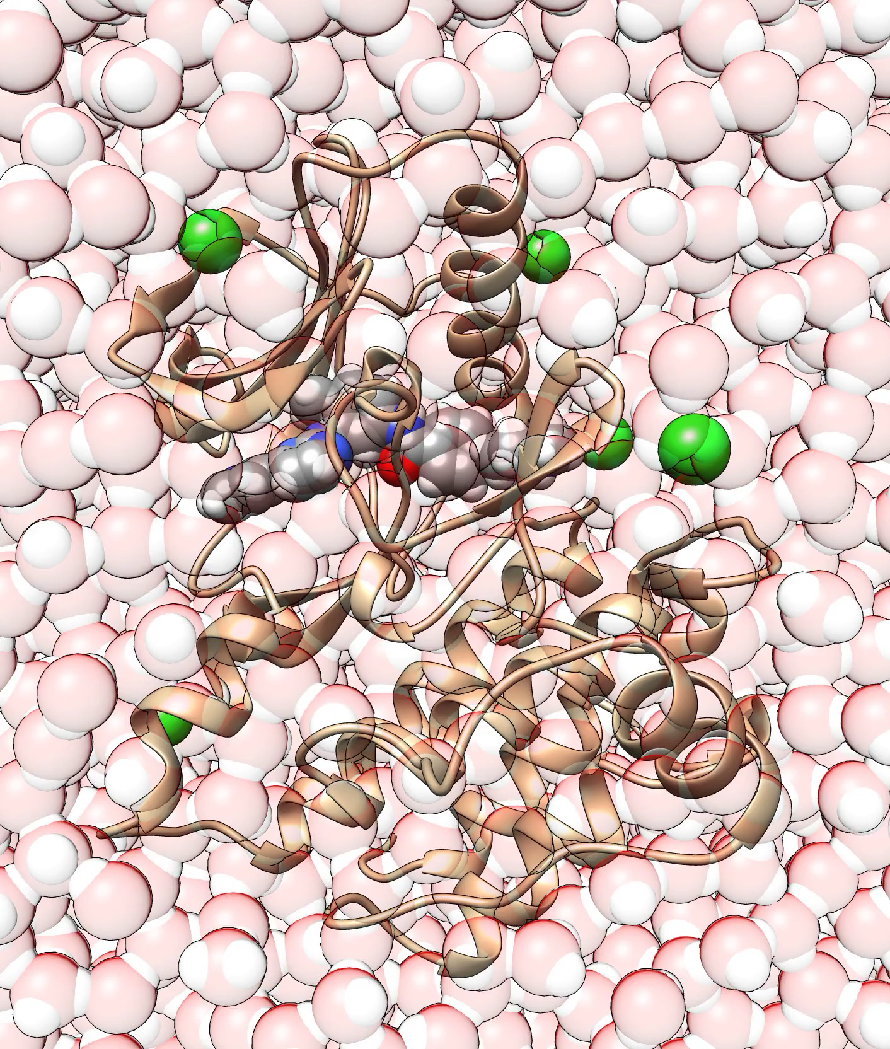
Part 1: Why we do MD?
… because of “wiggling & jiggling”
At the atomic scale, molecular motions are very significant
but they are too small & too fast to be directly observed experimentally
Only computer simulations based on the laws of physics enable us to see these motions
MD ≡ “computational microscope”

Slide 5
Reason people do MD
In the hope that something amazing will happen
see how proteins fold
see pathways through which ligands reach buried binding sites in proteins
see how transporter proteins chaperone molecules across membranes
In the hope that nothing amazing will happen
predict thermodynamic quantities (e.g., ligand binding affinities)
But not “I wonder what will happen if I run MD on this?”

Slide 6

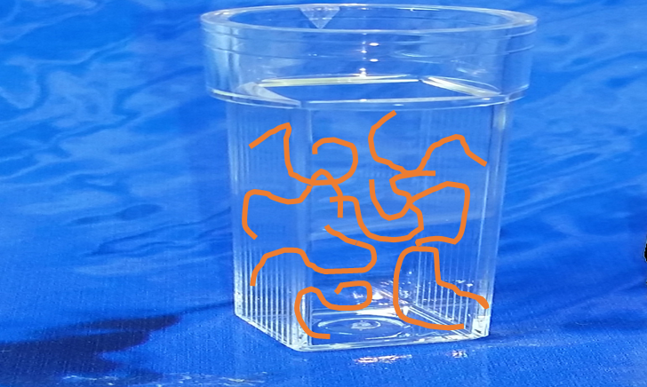
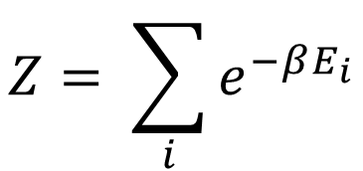
Simulations: from micro to macro
Looking at a single molecule over a period of time (MD):
It’s like looking at a collection of molecules at a moment in time (wet lab experiment)
For thermodynamics, we need the partition function:
$$Z= \sum_{i}{e^{−βE_{i}}}$$

Slide 7
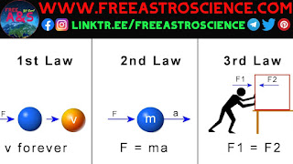
Part 2: How MD works?
The physics of molecular motion
In the absence of any F_{ext}, an atom w/ some KE will move in a straight line at const V (Law of inertia)
If it experiences a F (e.g., interaction w/ another atom), it will accelerate or change V &/or direction (Law of acceleration)
https://www.freeastroscience.com/2023/03/newtons-three-laws-of-motion.html

Slide 8
Molecular dynamics simulations
Time series & iterative process
Predictions of how
x of atoms will change as f(t) → V
F will change as f(t)

Slide 9
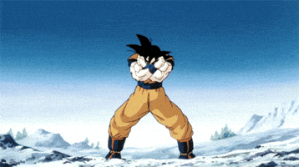
Molecular dynamics as animation
Given a set of atomic x & V, calculate the F acting on each atom at the current instant
Based on current V & F, calculate the x of the atoms a small t* later
Go back to step 1 & repeat
*1-2 femtoseconds!
https://giphy.com/explore/dragon-ball-z

Slide 10
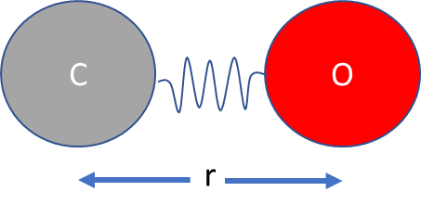
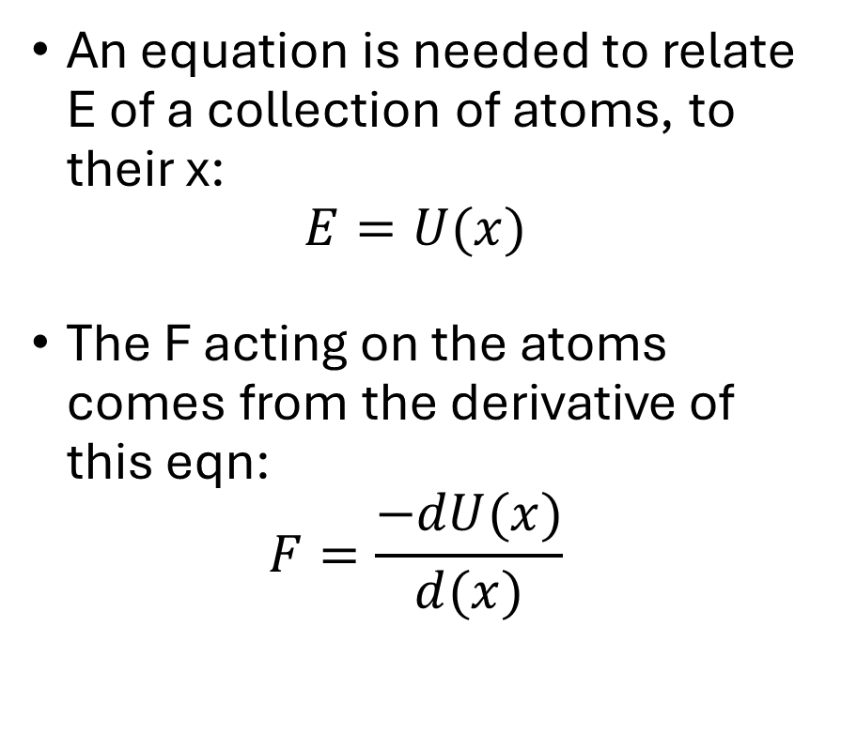
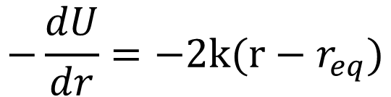
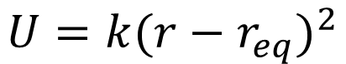
Calculating forces
An equation is needed to relate E of a collection of atoms, to their x:
$$E=U(x)$$
The F acting on the atoms comes from the derivative of this eqn:
$$F=\frac{−dU(x)}{d(x)}$$
Carbon monoxide
$$U=k{(r−r_{eq})}^{2}$$
$$−\frac{dU}{dr}=−2k(r−r_{eq})$$
2 atoms, 2 parameters

Slide 11
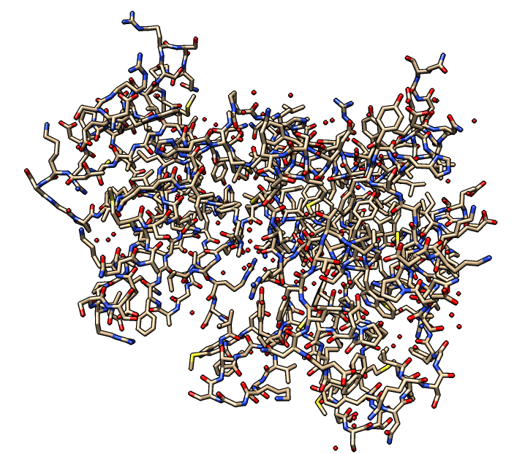
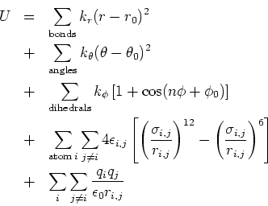
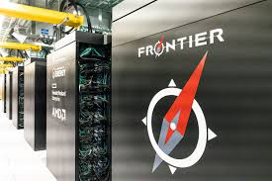
Calculating forces
These equations can be complex!
Computationally expensive
Most supercomputers:
< 1 M atoms
< 1 μs
Frontier of ORNL: ~0.5 T atoms
A small protein
38,000 atoms, 70,000 parameters
https://www.ornl.gov/news/frontier-supercomputer-debuts-worlds-fastest-breaking-exascale-barrier

Slide 12

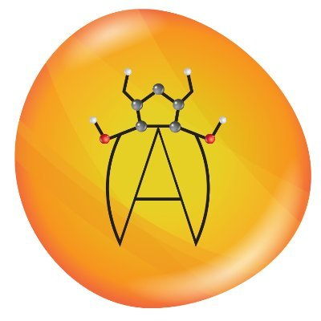
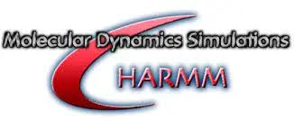

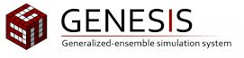

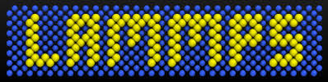
Part 3: How we do MD?
MD packages
Contain:
An energy function (U) ≡ forcefield
A “precooked” library of parameters for standard molecular systems
Software to actually perform the MD simulation
Amber

Slide 13
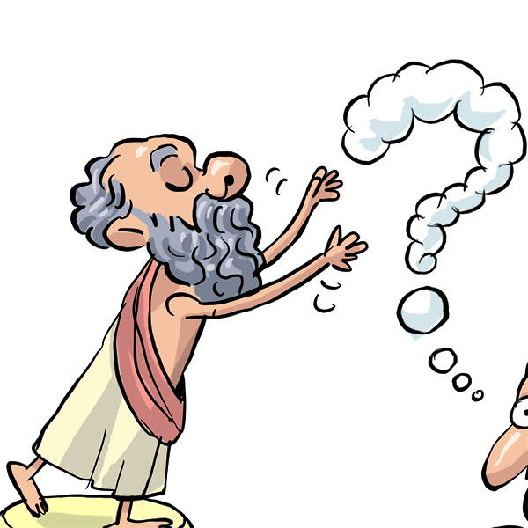
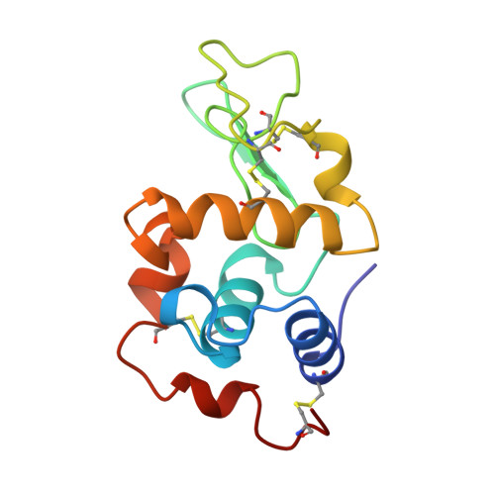

MD simulation workflow
STEP 1: Experimental design
STEP 2: Find or generate a structure
KVFGRCELAA…
AVQAWIRGCRL
AlpaFold3?
Limitations of AlphaFold3:
issue with chirality
hallucinations in disordered
regions
static structure
conformational changes
https://libraryforkids.com/socrates-the-virtuous-enigmatic-philosopher/

Slide 14
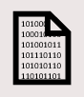
MD simulation workflow
STEP 3: Prepare PDB
STEP 4: Generate topology
Check the following:
Non-standard residues
Metals
Exp methods (MODRES)
Solvent or crystallization buffer
Missing amino acids
Disulfide bonds
Protonation states
Amber
CHARMM
OPLS
Gromos?
OPLS ≡ Optimized Potentials for Liquid
Simulations
CHARMM ≡ Chemistry at Harvard Macromolecular Mechanics

Slide 15
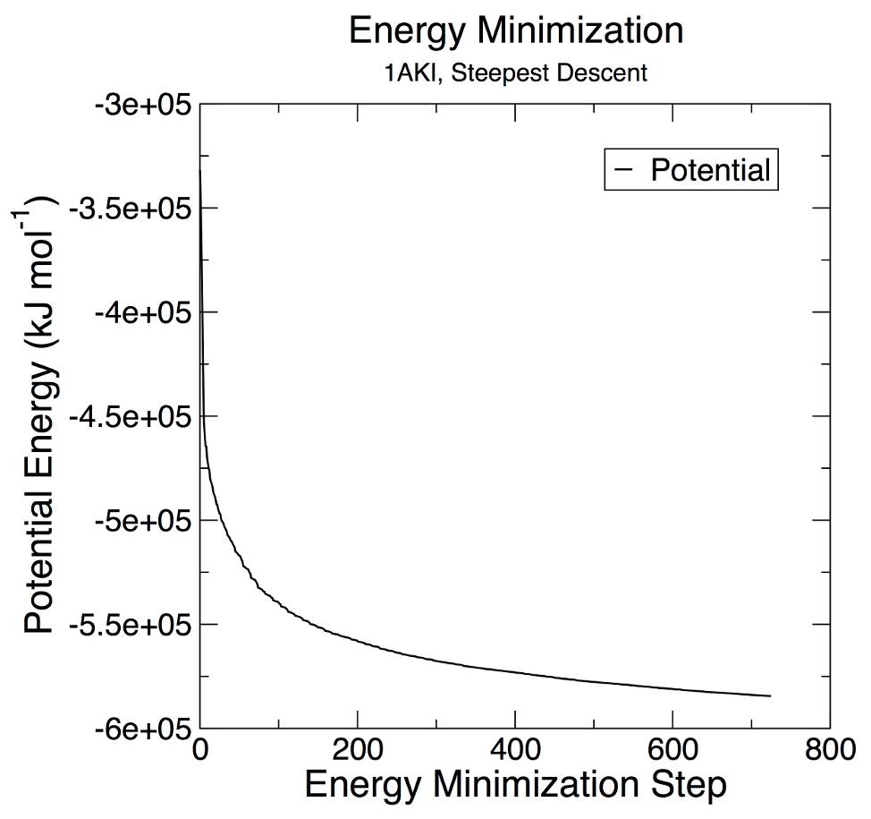
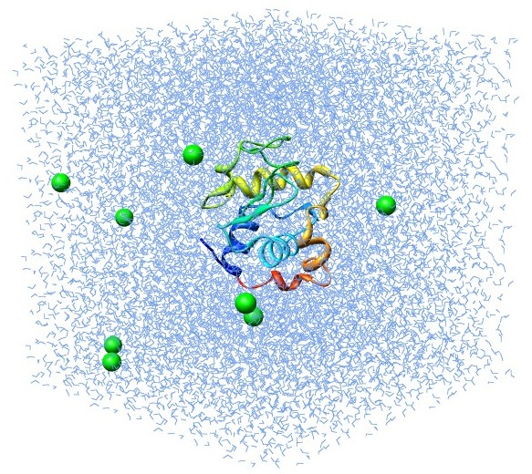
MD simulation workflow
STEP 5: Define box, solvate & add ions
STEP 6: Energy minimization
http://www.mdtutorials.com/gmx/lysozyme/05_EM.html

Slide 16
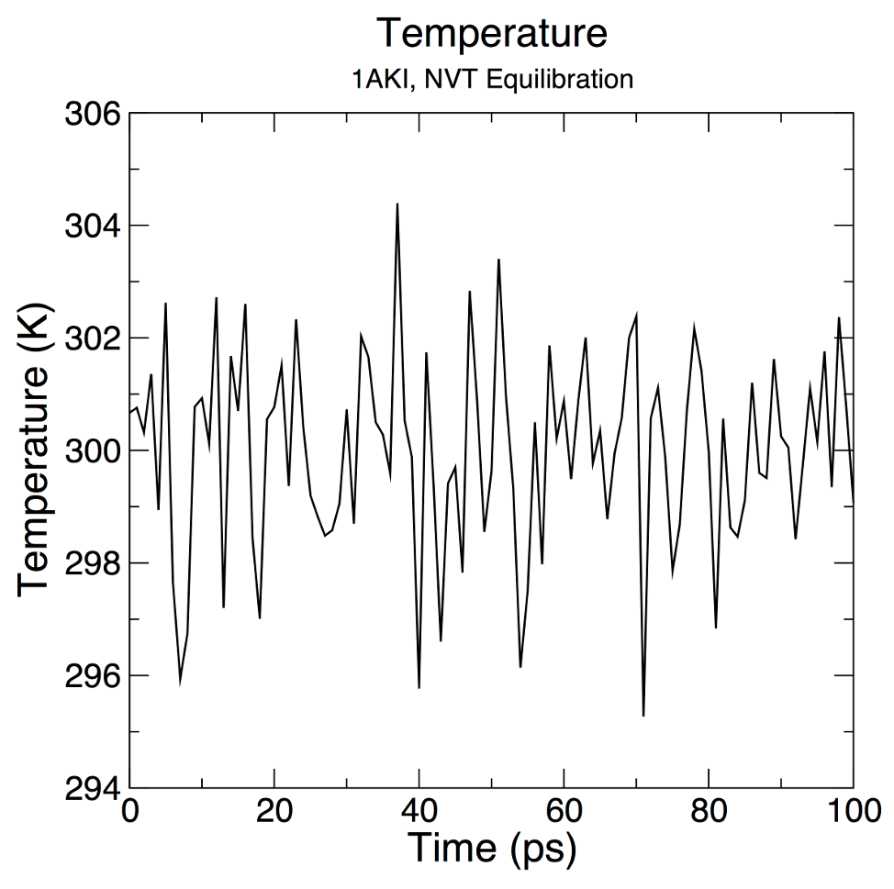
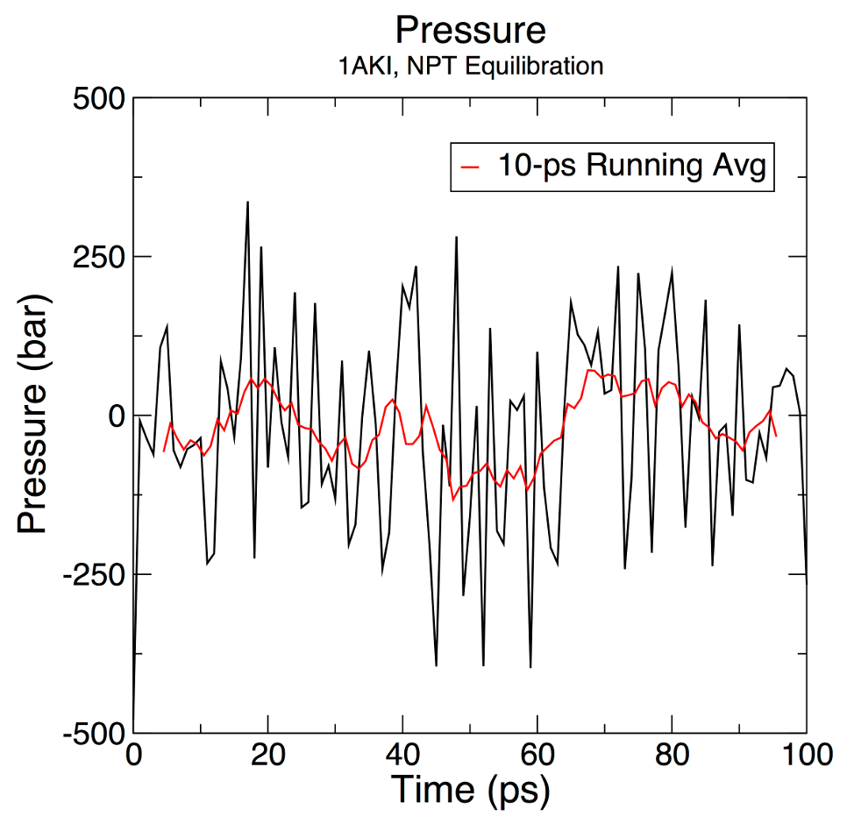
MD simulation workflow
STEP 7: NVT Equilibration
STEP 8: NPT Equilibration

Slide 17

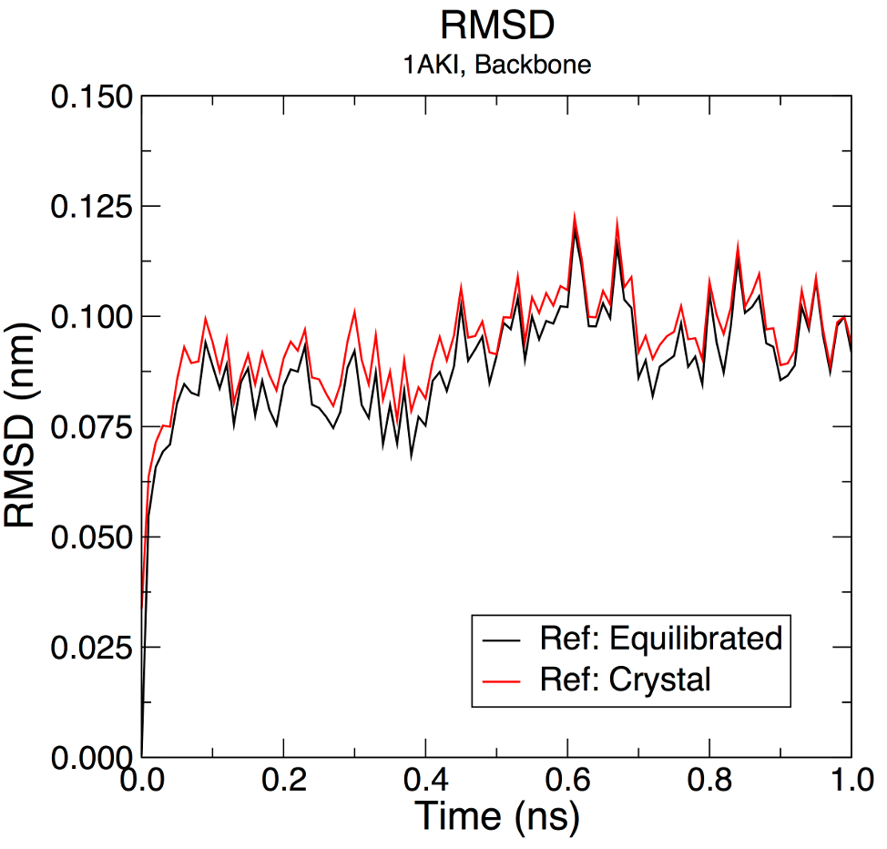

MD simulation workflow
STEP 9: Production MD
STEP 10: Analysis
Root mean squared deviation – asses convergence
Equilibrated
system

Slide 18
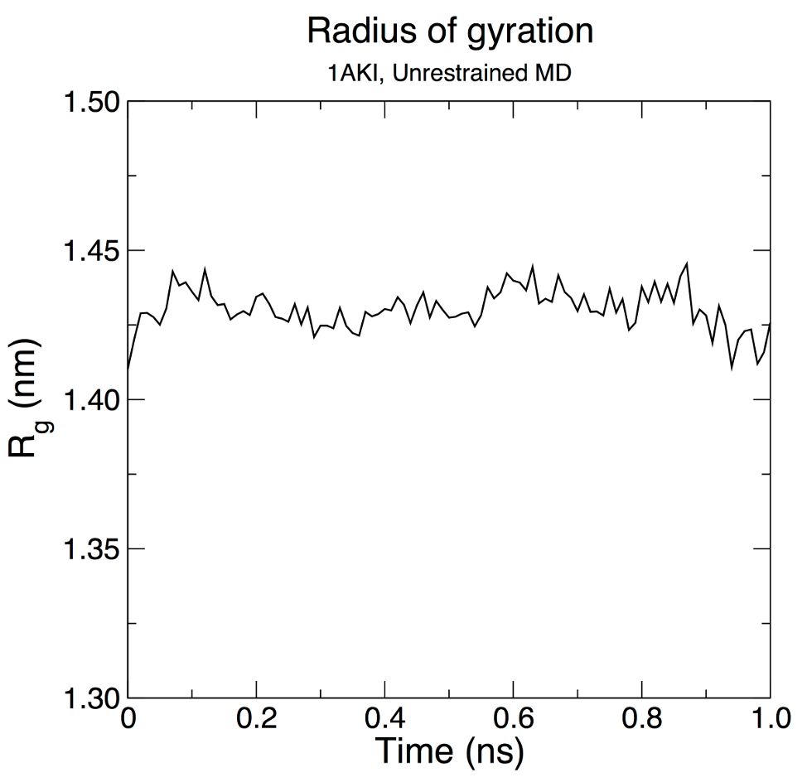
MD simulation workflow
STEP 10: Analysis
Radius of gyration – compactness, the smaller value, the more compact
Root mean squared (RMSF) – flexibility of residues in the protein
2D RSMD – overview of conformation changes & stability of protein during MD
PCA – reduce the dimensionality of MD data; identify the most significant mode of motion
Pearson’s cross-correlation – relationship between the motions of different residues within a protein

Slide 19
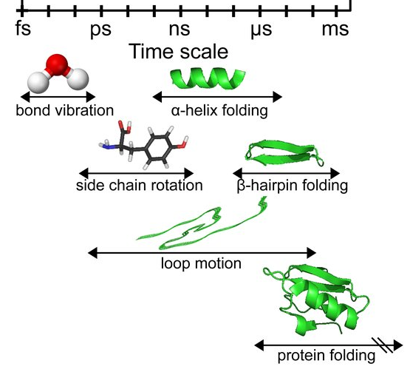
How long should I run MD?

Slide 20
Part 4: What are the limitations of MD?
Magnetic & electrical properties of materials (needs QM)
Calculate the energy of molecular conformation (needs QM)
Protease-catalyzed reactions involving electron transfer (needs QM/MM)
Chemical reactions involving electron transfer (needs QM/mm)
https://portal.valencelabs.com/blogs/post/an-introduction-to-molecular-dynamics-simulations-C9nXeGJ8hbNYghL

Slide 21
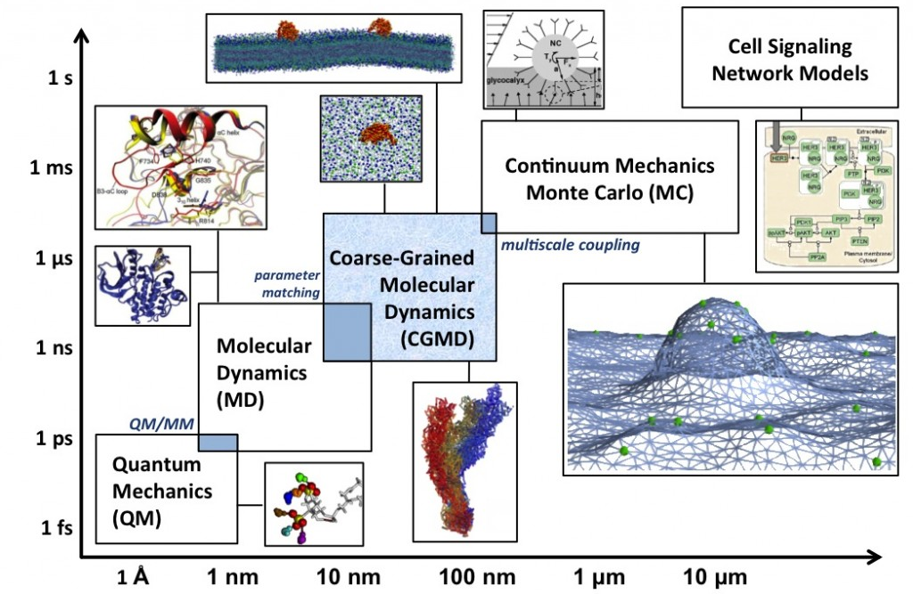
Other computational methods

Slide 22
For more tutorials & workshops
MD in Google Colab tutorials: https://github.com/pablo-arantes/making-it-rain
CompBio Asia workshop: https://compbioasia.net/
Bovin lab’s tutorial on MD: https://www.bonvinlab.org/education/molmod/simulation
Lemkul’s Gromacs tutorials: http://www.mdtutorials.com/gmx/index.html
Amber tutorial: https://ambermd.org/tutorials/
OpenMM tutorials: http://docs.openmm.org/latest/userguide/library/03_tutorials.html
NAMD tutorials: https://www.ks.uiuc.edu/Training/Tutorials/namd-index.html
GAMD tutorials: https://www.youtube.com/watch?v=f4faPQU58oA

Slide 23


Slide 24
Molecular Dynamics
Prelab 4

Slide 25
What you will need for the MD workshop?
Google Colab account: https://colab.research.google.com/
AlphaFold3 server account: https://alphafoldserver.com/
CIF to PDB converter: https://project-gemmi.github.io/wasm/convert/cif2pdb.html
Install ChimeraX: https://www.cgl.ucsf.edu/chimerax/download.html
PDB of either:
anoplin (PDB ID: 2MJQ) or
temporin-SHf: FFFLSRIF-NH₂

